Slide 1

DETECTING AND CAPTIONING IMAGES USING CNN-LSTM DEEP NEURAL NETWORKS AND FLASK
UNDER GUIDANCE OF
Dr. P. VENKATESWARA RAO
PROFESSOR & HOD
DEPARTMENT OF CSE
PRESENTED BY
P.YASWANTH SAI (15F11A0563)
SK.ANEEF (16F15A0501)
T.SAI HARISH (15F11A0585)

Slide 2
ABSTRACT
Captioning images automatically is one of the heart of the human visual system. There are various advantages if there is an application which automatically caption the scenes surrounded by them and revert back the caption as a plain message. In this paper, we present a model based on CNN-LSTM neural networks which automatically detects the objects in the images and generations descriptions for the images. This model can perform two operations. The first one is to detect objects in the image using convolutional neural networks and the other is to caption the images using RNN based LSTM. Interface of the model is developed using flask rest API, which is a web development framework of python. The main use case of this project is to help visually impaired to understand the surrounding environment and act according to that.

Slide 3
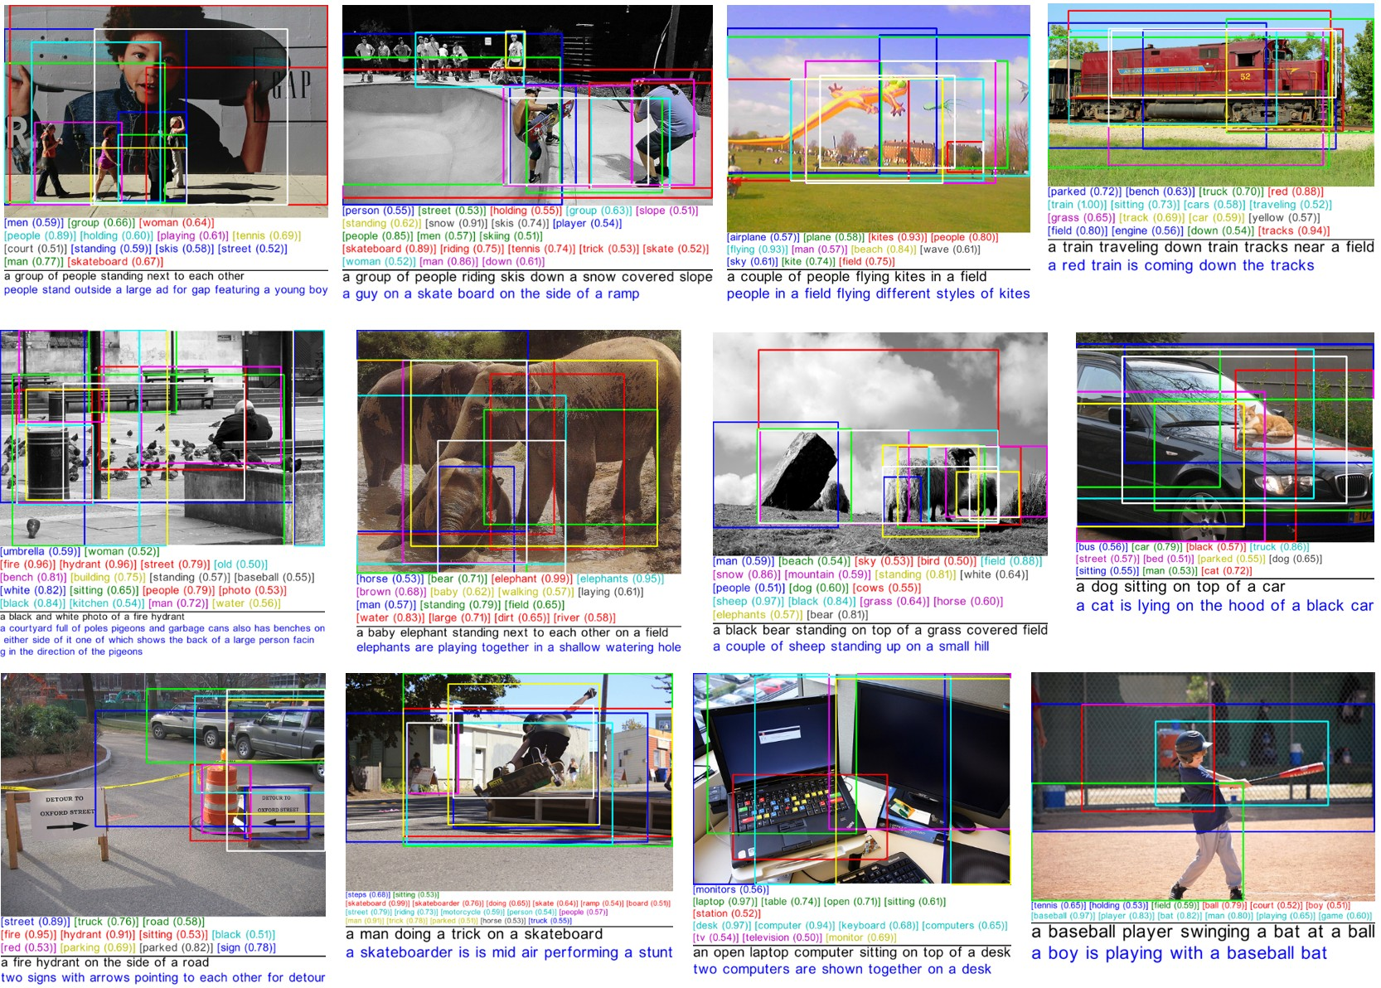

Slide 4
EXISTING SYSTEM
Three papers we are going to discuss to define the existing system:
Deep Visual-Semantic Alignments for Generating Image Descriptions
Sentences act as weak labels : contiguous sequences of words correspond to some particular (unknown) location in image.
Show and Tell: A Neural Image Caption Generator
Works fine only with images within dataset.
Deep Captioning with Multimodal Recurrent Nets
Very complex and time taking strategy, which is very difficult and costlier to deploy in real world.

Slide 5
PROPOSED SYSTEM
DETECTING OBJECTS
CNN
CONVERTING TO NATURAL LANGUAGE
RNN & LSTM
GENERATING CAPTIONS
Using vigorous training and pre-trained libraries of python

Slide 6
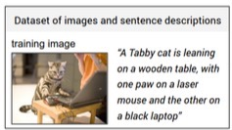
DATASETS USED
Flickr8k
8000 images, each annotated with 5 sentences via AMT
1000 for validation, testing
Flickr30k
30k images
1000 validation, 1000 testing
MSCOCO
123,000 images
5000 for validation, testing

Slide 7
SYSTEM REQUIREMENTS
Hardware Requirements Recommendation:
RAM: 4 GB (minimum)
Hard disk: 500 GB
Software Requirements Recommendation:
Operating System : Windows (above 7 64-bit), Linux and MAC
Web Interface : Flask Rest API ( Python Web Framework)
Programming Language: Python
Libraries : Tensorflow, Keras, Numpy, PIL, Flask-python, captionBot
Browser: Chrome , Firefox

Slide 8
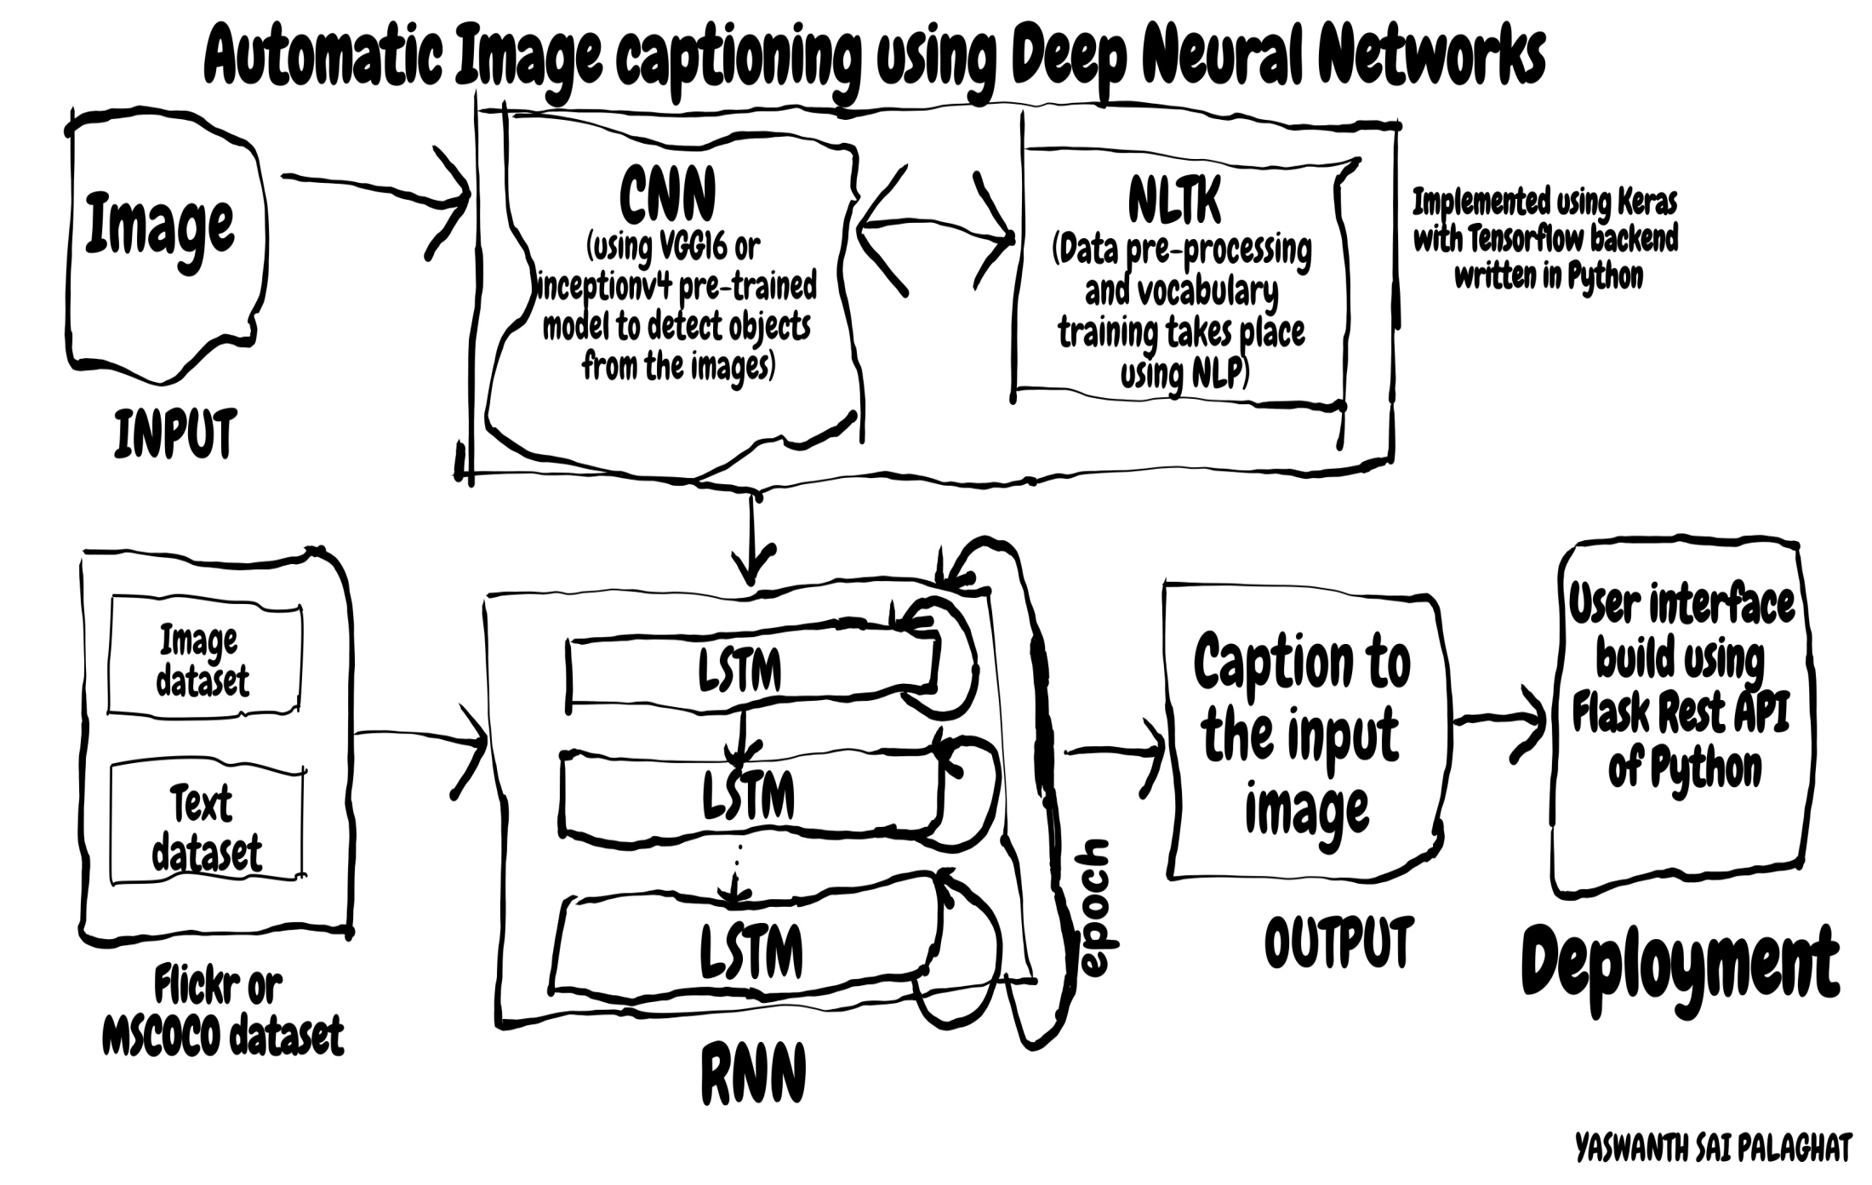
ARCHITECTURE DIAGRAM OF THE PROJECT

Slide 9
MODULAR DIVISION OF THE PROJECT
Creating pre-trained model (Transfer Learning)
Object detection
Sentence Generation
Ranking based caption retrieval
Deployment to Web Server

Slide 10
TRANSFER LEARNING
Transfer learning is computer vision’s popular method ,because it allows us to build accurate models in a timesaving manner.
With transfer learning, instead of starting the learning process from scratch, you start from patterns that have been learned when solving a different problem.
In computer vision, transfer learning is usually expressed through the use of pre-trained models.

Slide 11
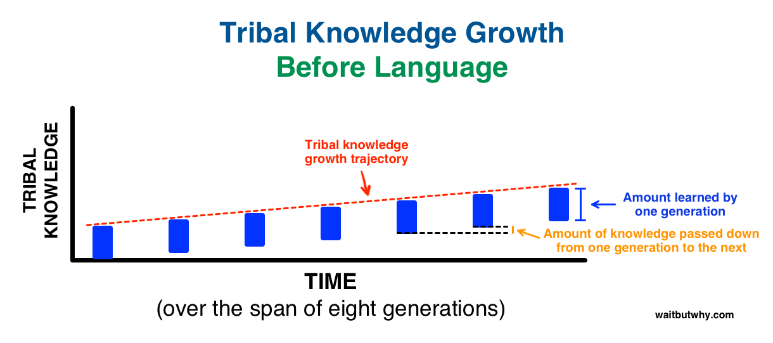

Slide 12
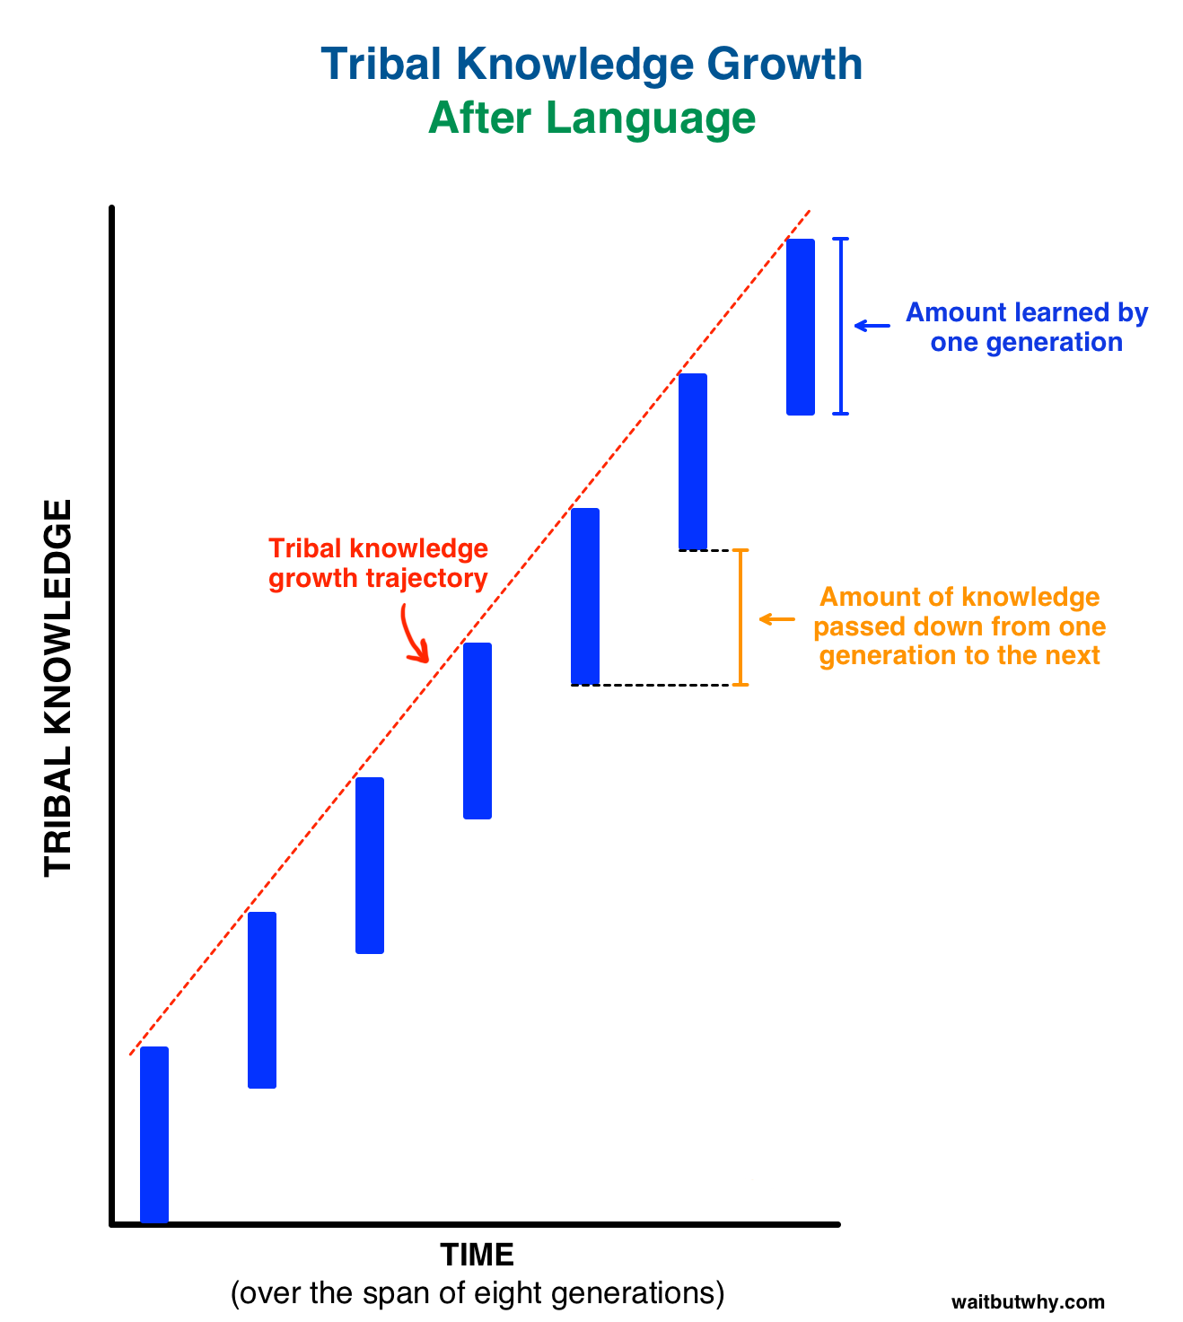

Slide 13
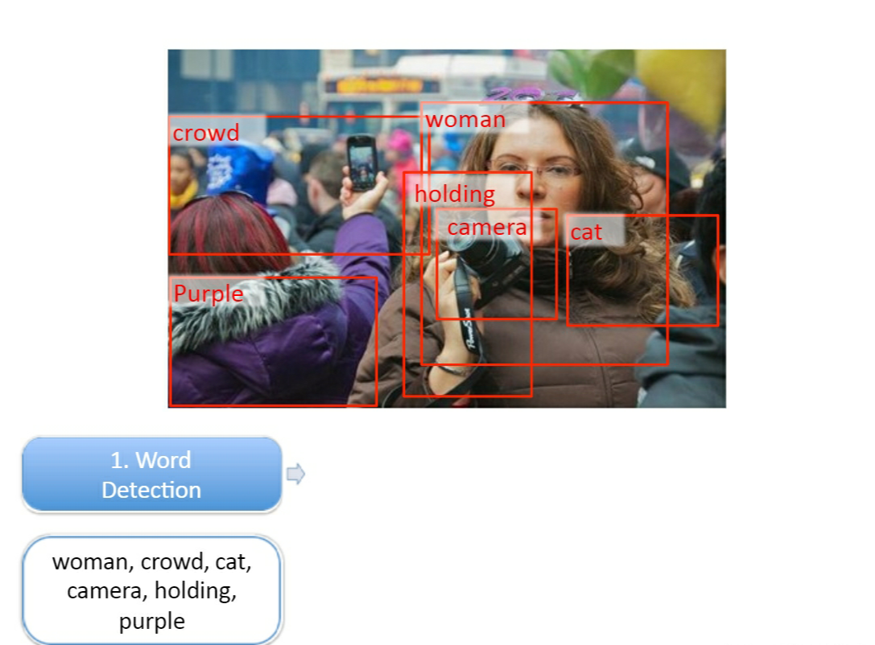
OBJECT DETECTION/WORD DETECTION

Slide 14
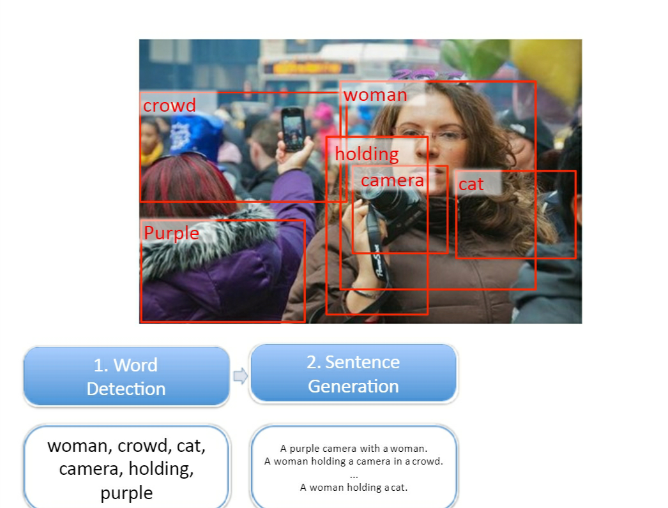
SENTENCE GENERATION

Slide 15
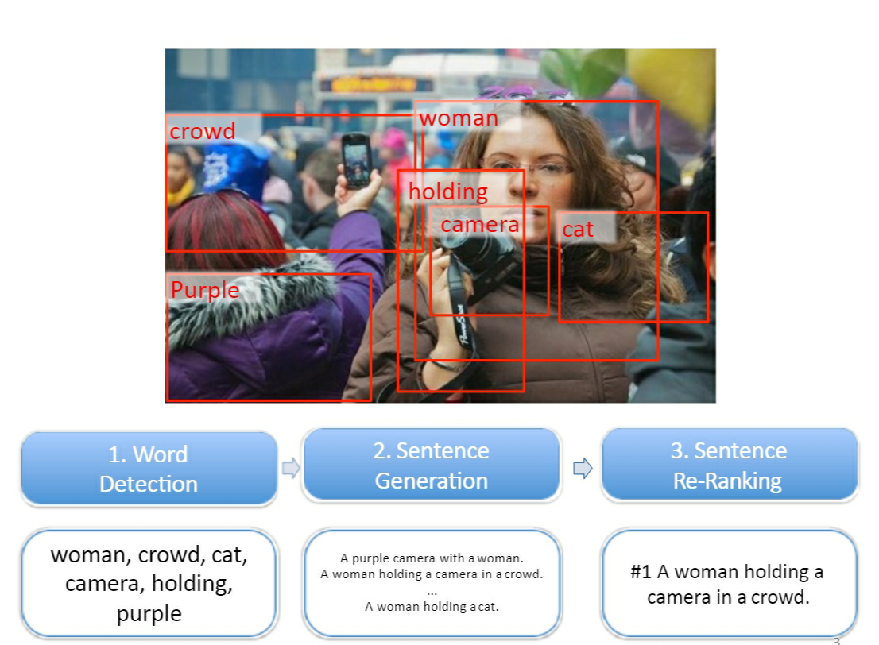
RANKING BASED CAPTION RETRIEVAL

Slide 16
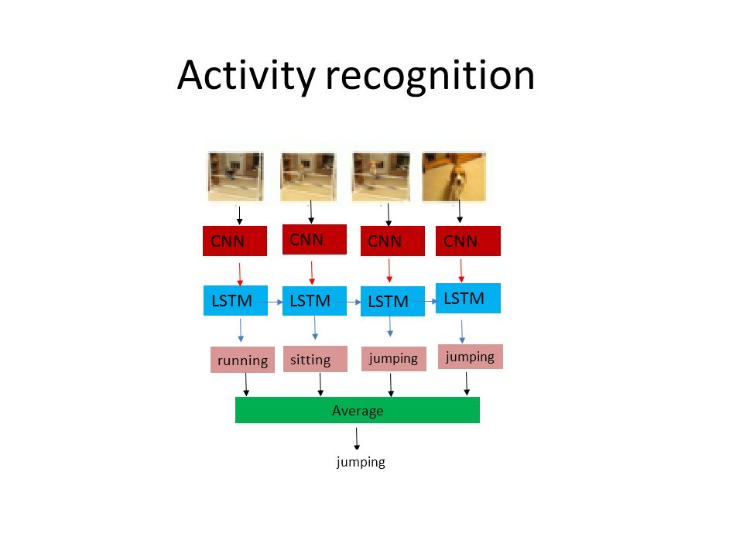

Slide 17
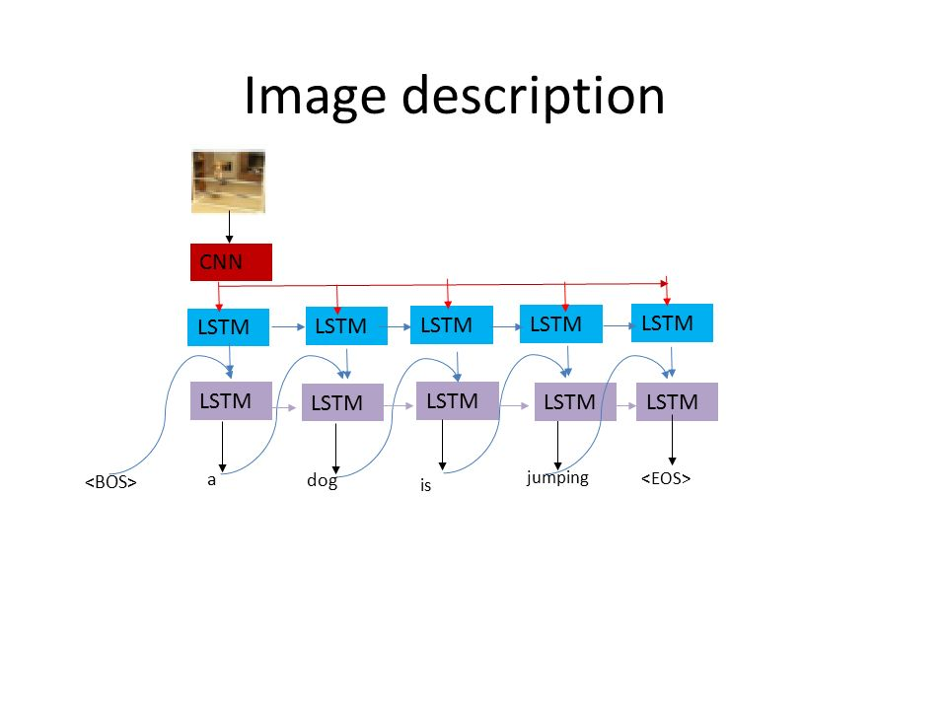

Slide 18
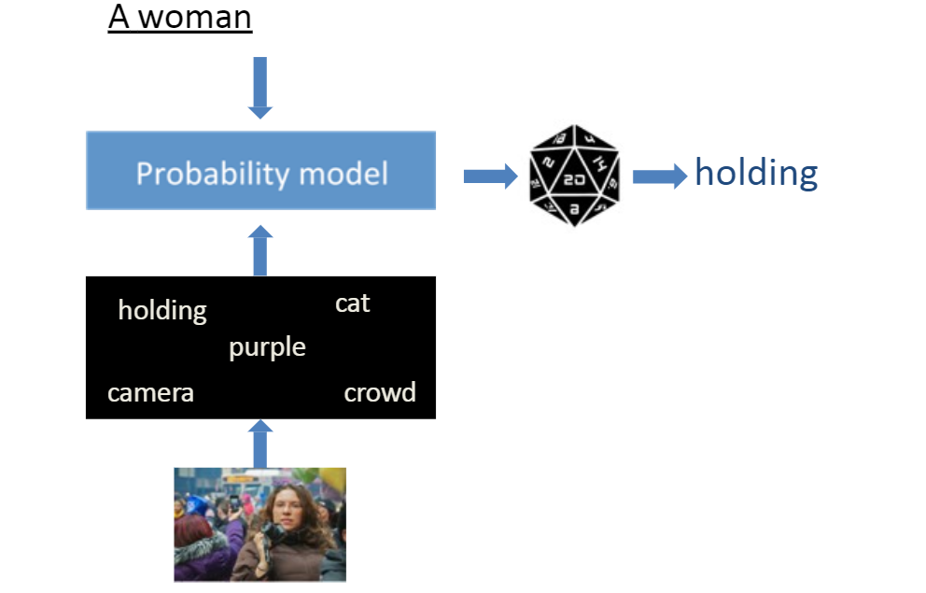
NLP PROBABILISTIC MODEL

Slide 19
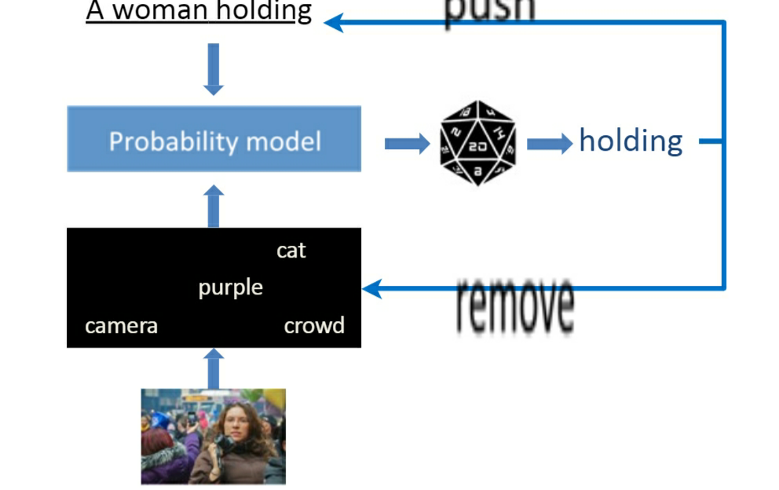
NLP PROBABILISTIC MODEL

Slide 20
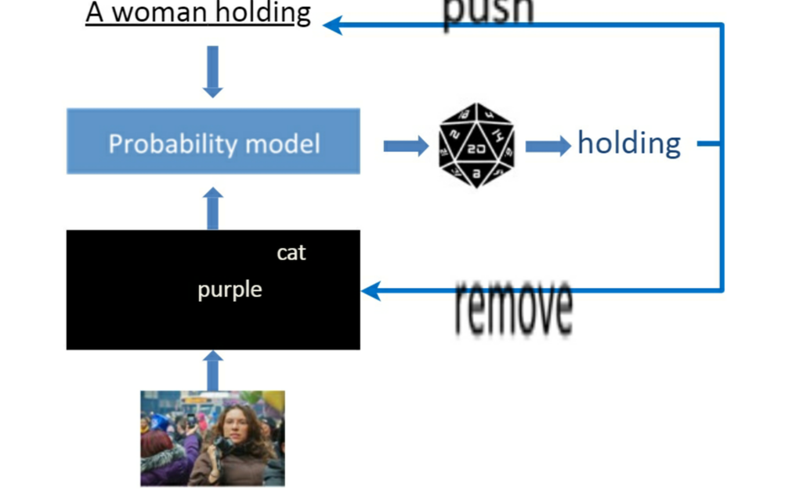
NLP PROBABILISTIC MODEL

Slide 21
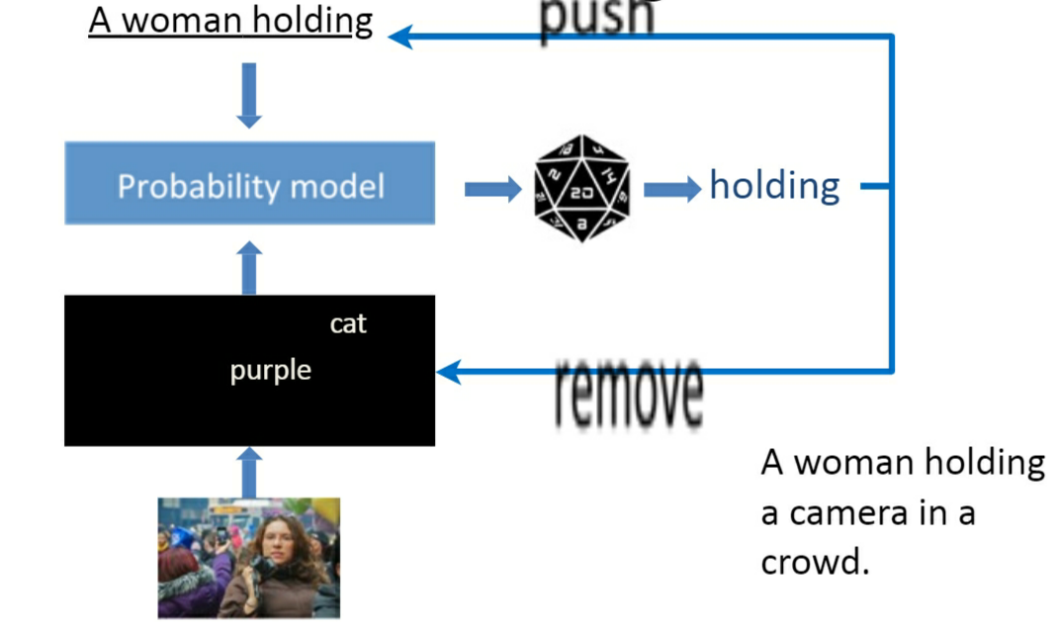
NLP PROBABILISTIC MODEL

Slide 22

WORKING OF CNN
CNN stands for CONVOLUTIONAL NEURAL NETWORK.

Slide 23
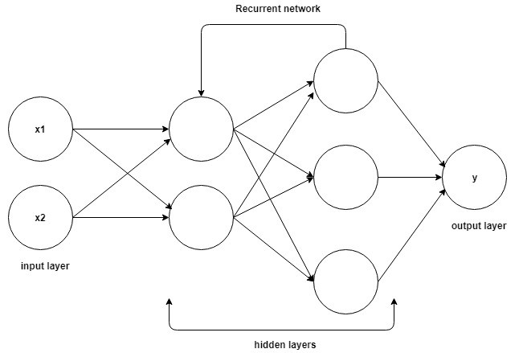
WORKING OF RNN
RNN stands for RECURRENT NEURAL NETWORK.
[S_{t}=F(S_{t-1}+W_{t})]

Slide 24
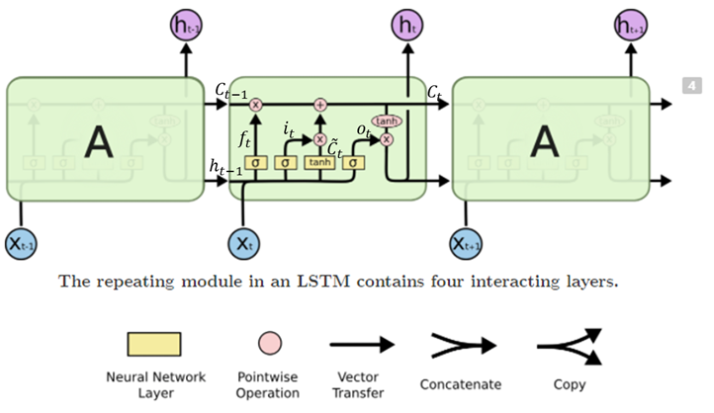
WORKING OF LSTM
LSTM stands for LONG SHORT TERM MEMORY.

Slide 25
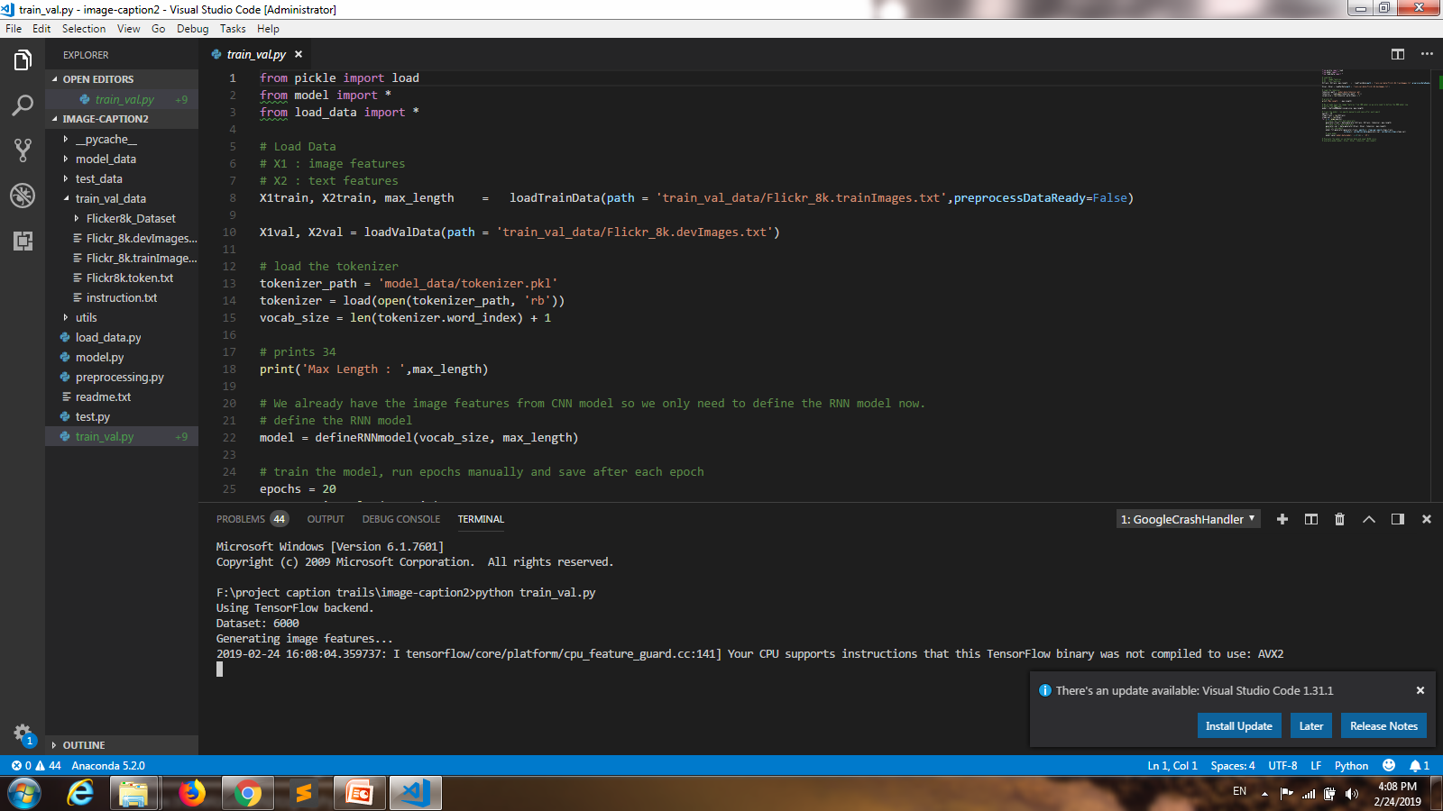

Slide 26
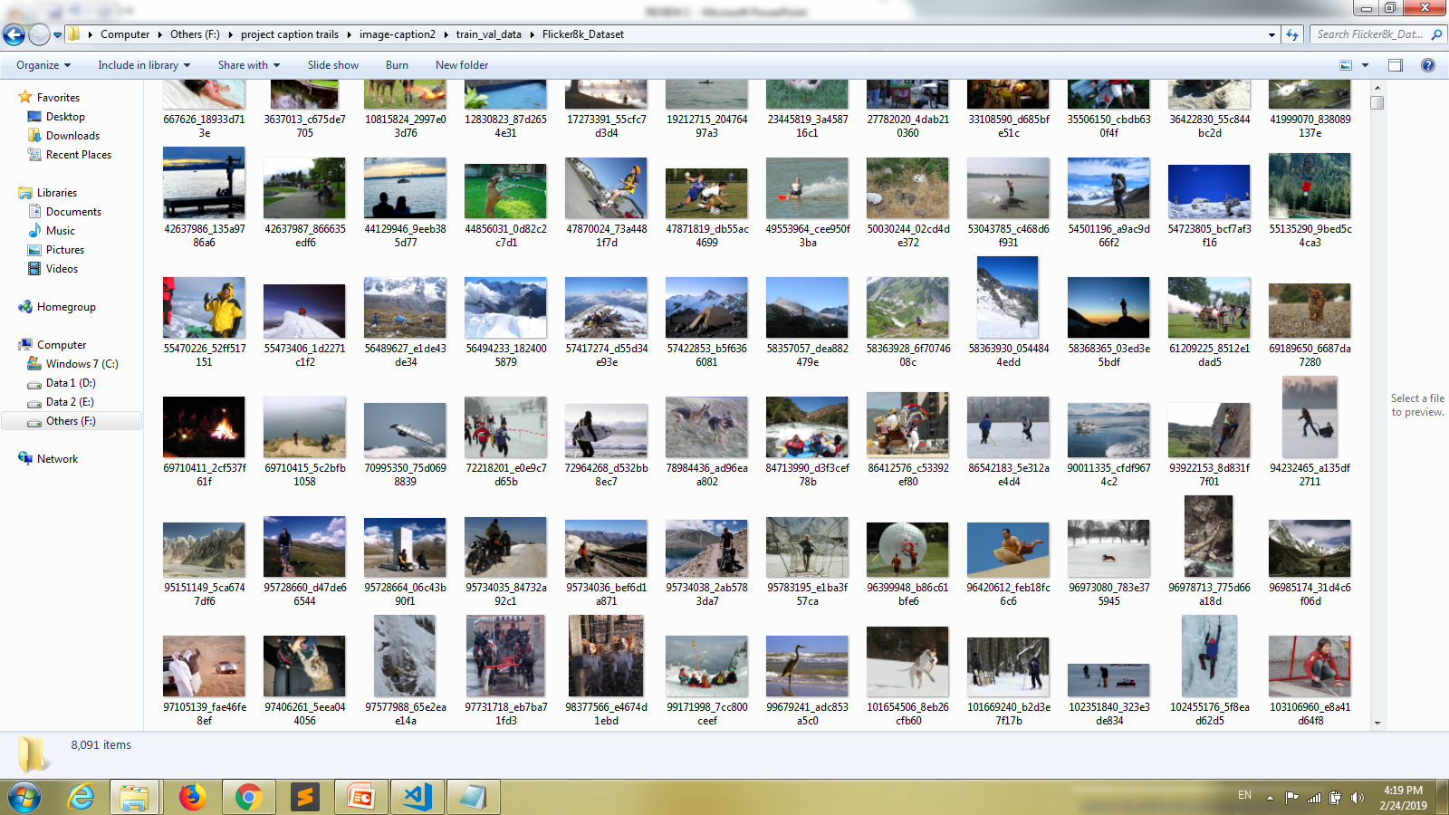

Slide 27
PRE TRAINED FILES
Descriptions.txt
Features.pkl
Tokenizer.pkl
Model.h5

Slide 28
LIBRARIES USED
TENSORFLOW
KERAS
PICKLE
NLTK

Slide 29
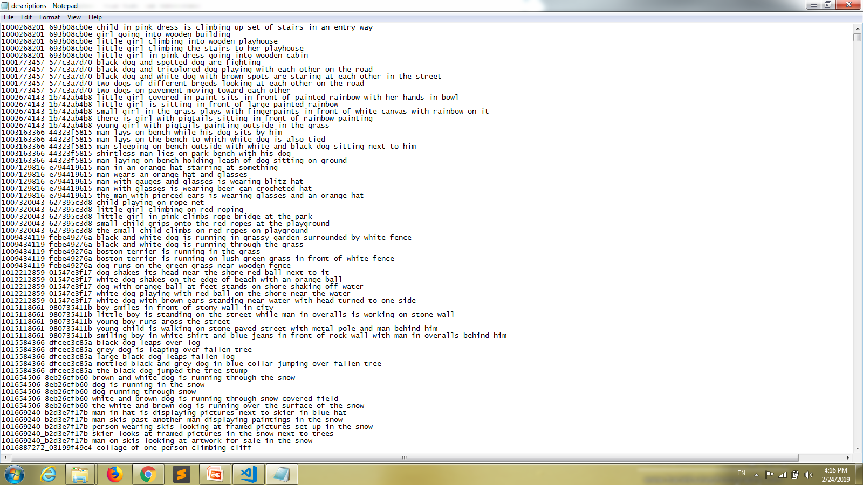

Slide 30


Slide 31
DEPLOYING AS A WEB APPLICATION
We have used FLASK to deploy our project as a REST-API in the form of a web application.
FLASK is a web application framework of PYTHON used mostly to deploy machine learning models.

Slide 32
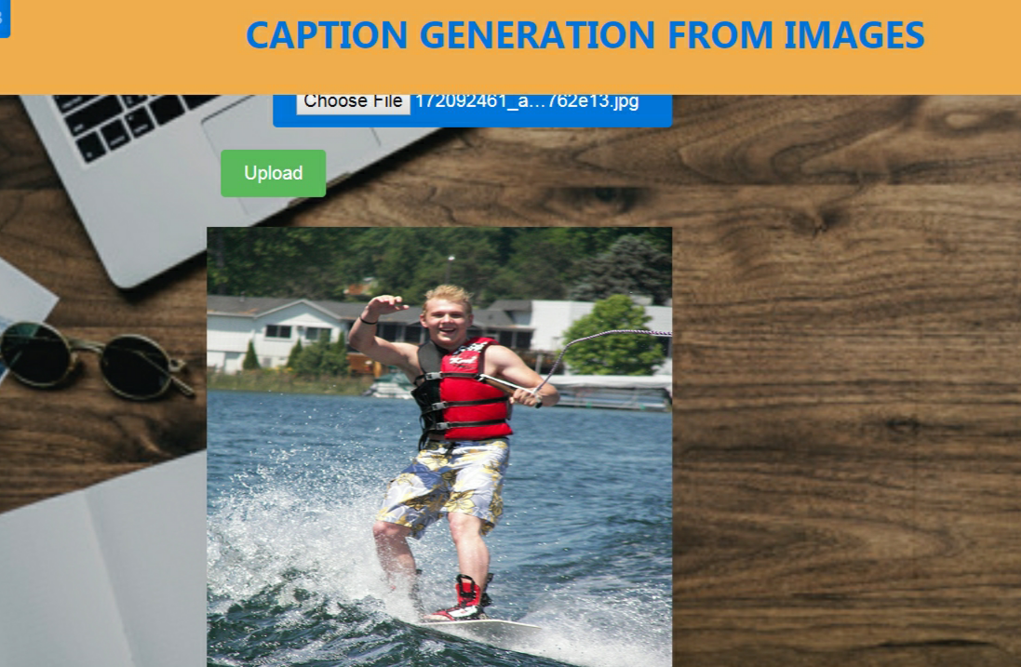
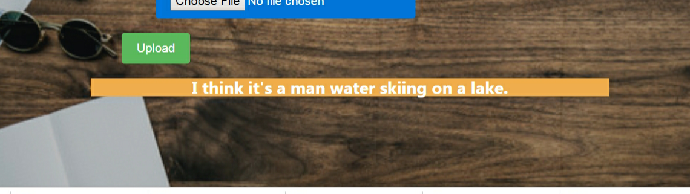

Slide 33
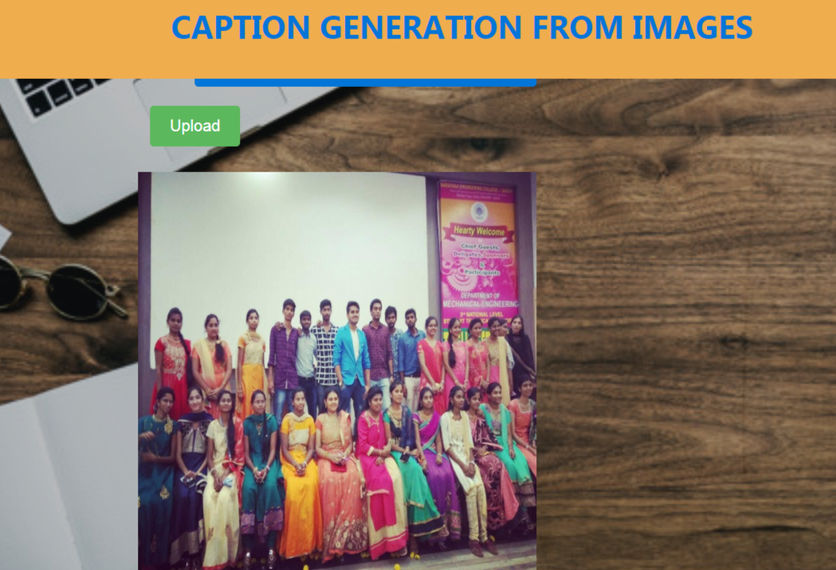
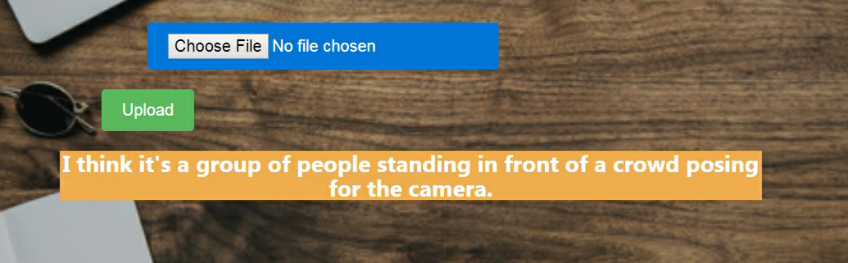

Slide 34


